Slide 1
Advent 2 – The Shepherds

Slide 2
Luke 2 v 8 -20
“And in the same region there were shepherds out in the field, keeping watch over their flock by night. And an angel of the Lord appeared to them, and the glory of the Lord shone around them, and they were filled with great fear. And the angel said to them, “Fear not, for behold, I bring you good news of great joy that will be for all the people.

Slide 3
For unto you is born this day in the city of David a Savior, who is Christ the Lord. And this will be a sign for you: you will find a baby wrapped in swaddling cloths and lying in a manger.” And suddenly there was with the angel a multitude of the heavenly host praising God and saying, “Glory to God in the highest, and on earth peace among those with whom he is pleased!” When the angels went away from them into heaven, the shepherds said to one another, “Let us go over to Bethlehem and see this thing that has happened, which the Lord has made known to us.” And they went with haste and found Mary and Joseph, and the baby lying in a manger.

Slide 4
And when they saw it, they made known the saying that had been told them concerning this child. And all who heard it wondered at what the shepherds told them. But Mary treasured up all these things, pondering them in her heart. And the shepherds returned, glorifying and praising God for all they had heard and seen, as it had been told them.”

Slide 5
Shepherds
A bit of a theme – From Job 14000 sheep to Jesus – The Good Shepherd
The Story
The Message
Why shepherds? What about me?

Slide 6
Shepherds in the bible

Slide 7
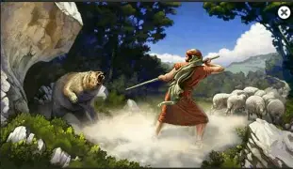

Slide 8
Psalm 23
“The Lord is my shepherd; I shall not want. He makes me lie down in green pastures. He leads me beside still waters. He restores my soul. He leads me in paths of righteousness for his name’s sake. Even though I walk through the valley of the shadow of death, I will fear no evil, for you are with me; your rod and your staff, they comfort me. You prepare a table before me in the presence of my enemies; you anoint my head with oil; my cup overflows. Surely goodness and mercy shall follow me all the days of my life, and I shall dwell in the house of the Lord forever.”

Slide 9
Amos‬ ‭1‬ v 1‬
“The words of Amos, who was among the shepherds of Tekoa, which he saw concerning Israel in the days of Uzziah king of Judah and in the days of Jeroboam the son of Joash, king of Israel, two years before the earthquake.” ‭‭

Slide 10
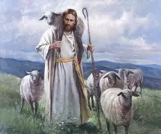

Slide 11
1 Peter‬ ‭5‬:‭1‬-‭4‬
“So I exhort the elders among you, as a fellow elder and a witness of the sufferings of Christ, as well as a partaker in the glory that is going to be revealed: shepherd the flock of God that is among you, exercising oversight, not under compulsion, but willingly, as God would have you; not for shameful gain, but eagerly; not domineering over those in your charge, but being examples to the flock. And when the chief Shepherd appears, you will receive the unfading crown of glory.” ‭‭

Slide 12
The Story

Slide 13
And in the same region there were shepherds out in the field, keeping watch over their flock by night

Slide 14
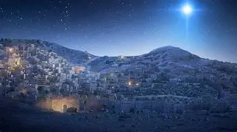

Slide 15
And an angel of the Lord appeared to them, and the glory of the Lord shone around them, and they were filled with great fear

Slide 16
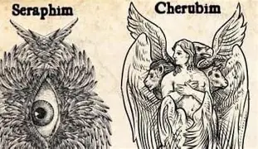
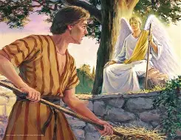
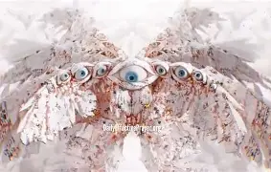

Slide 17
“Then the angel of the Lord reached out the tip of the staff that was in his hand and touched the meat and the unleavened cakes. And fire sprang up from the rock and consumed the meat and the unleavened cakes. And the angel of the Lord vanished from his sight. Then Gideon perceived that he was the angel of the Lord. And Gideon said, “Alas, O Lord God! For now I have seen the angel of the Lord face to face.”” ‭‭Judges‬ ‭6‬:‭21‬-‭22

Slide 18
The Message

Slide 19
Micah‬ ‭5‬:‭2‬-‭5
“But you, O Bethlehem Ephrathah, who are too little to be among the clans of Judah, from you shall come forth for me one who is to be ruler in Israel, whose coming forth is from of old, from ancient days. Therefore he shall give them up until the time when she who is in labor has given birth; then the rest of his brothers shall return to the people of Israel. And he shall stand and shepherd his flock in the strength of the Lord, in the majesty of the name of the Lord his God. And they shall dwell secure, for now he shall be great to the ends of the earth. And he shall be their peace. ‭‭

Slide 20
Isaiah‬ ‭9‬:‭6‬-‭7
“For to us a child is born, to us a son is given; and the government shall be upon his shoulder, and his name shall be called Wonderful Counselor, Mighty God, Everlasting Father, Prince of Peace. Of the increase of his government and of peace there will be no end, on the throne of David and over his kingdom, to establish it and to uphold it with justice and with righteousness from this time forth and forevermore. The zeal of the Lord of hosts will do this.” ‭‭

Slide 21
Why shepherds? What about me?
Awake?
Available?
Ready to go?
Tell people?

Slide 22
““But concerning that day or that hour, no one knows, not even the angels in heaven, nor the Son, but only the Father. Be on guard, keep awake. For you do not know when the time will come.” ‭‭Mark‬ ‭13‬:‭32‬-‭33

Slide 23
The Facts
Doubt or believe
Bethlehem – Are you sure
Signs
Creation

Slide 24
“For what can be known about God is plain to them, because God has shown it to them. For his invisible attributes, namely, his eternal power and divine nature, have been clearly perceived, ever since the creation of the world, in the things that have been made. So they are without excuse.” ‭‭Romans‬ ‭1‬:‭19‬-‭20

Slide 25
The Message
Good News or not news at all
Joy
Jesus has come – Christ the Lord

Slide 26
Isaiah‬ ‭9‬:‭6‬-‭7
“For to us a child is born, to us a son is given; and the government shall be upon his shoulder, and his name shall be called Wonderful Counselor, Mighty God, Everlasting Father, Prince of Peace. Of the increase of his government and of peace there will be no end, on the throne of David and over his kingdom, to establish it and to uphold it with justice and with righteousness from this time forth and forevermore. The zeal of the Lord of hosts will do this.” ‭‭

